Slide 1

PARALLEL COMPUTER ARCHITECTURE
18MCE22

Slide 2
Outline
Introduction
Classes of Computers
Defining Computer Architecture
Trends in Technology
Trends in power in Integrated Circuits
Trends in Cost
Dependability
Performance
Quantitative Principles of computer design

Slide 3
Why computer became so famous?
Computer business increased due to mass production of Microprocessor.
Making programing machine independent by eliminating assembly level programing.
Bringing Operating system, to ease the operation and lowering the cost and risk of bringing out new architecture.
RISC (Reduced Instruction Set Computer) architecture was brought that make simpler instructions. This increased the speed of operation by exploiting instruction level parallelism.
The Caches improved the speed of operation.

Slide 4
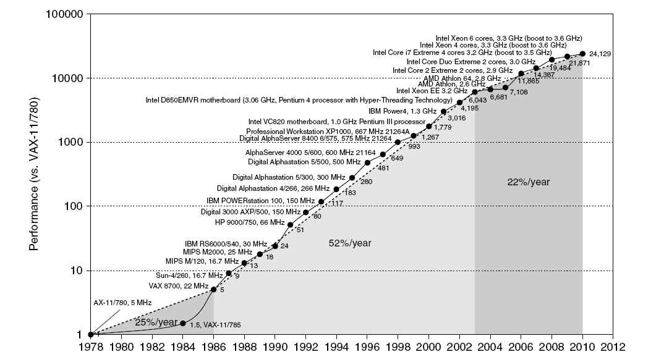
Single Processor Performance
Introduction
Move to multi-processor
RISC

Slide 5
The growth of computer usage has grown in multiple folds. Use of computers in application has gone in all walks of life. The highest-performance microprocessors of today outperforms the supercomputer of less than 10 years ago.
Cost-Performance has improved to large extent and hence there is large applications to which the computers have entered.
Starting from personal computers in 1980,
Smart cell phones and tablet computers in 1990
Mobile client devices usage has resulted in increasing use of internet to access warehouses containing tens of thousands of servers.

Slide 6
Hardware innovations has led to rebirth in computer design.
Software development has taken place 25000 folds in performance since 1978. Apart from programming languages such as Jave, C and C++, scripting languages like Python and Ruby are more productive.
Innumerable application has been developed. Example: Google Goggles application provided interesting information by holding cell phone to point its camera at an object. The image that is sent wirelessly over the internet to the warehouse-scale computer that recognizes the object and tells interesting information about it.
The hardware architecture has switched from relaying solely on instruction level parallelism (ILP), to data level parallelism (DLP) and thread-level parallelism (TLP).

Slide 7
Stack of A Computing Problem
Problems
Apps Trend
Algorithms
Programming Languages
Compilers
ISA
Architects’
Territory
System Architecture
Implementation
MicroArchitecture
Logic and Circuits
Transistors
Technology
Trend
Manufacturing

Slide 8
Crossroads: Conventional Wisdom in Comp. Arch
Old Conventional Wisdom: Power is free, Transistors expensive
New Conventional Wisdom: “Power wall” Power expensive, Xtors free (Can put more on chip than can afford to turn on)
Old CW: Sufficiently increasing Instruction Level Parallelism (ILP) via compilers, innovation (Out-of-order, speculation, …)
New CW: “ILP wall” law of diminishing returns on more HW for ILP
Old CW: Multiplies are slow, Memory access is fast

Slide 9
New CW: “Memory wall” Memory slow, multiplies fast (200 clock cycles to DRAM memory, 4 clocks for multiply)
Old CW: Uniprocessor performance 2X / 1.5 yrs
New CW: Power Wall + ILP Wall + Memory Wall = Brick Wall
Uniprocessor performance now 2X / 5(?) yrs
⇒ Sea change in chip design: multiple “cores” (2X processors per chip / ~ 2 years)
More simpler processors are more power efficient

Slide 10
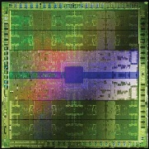
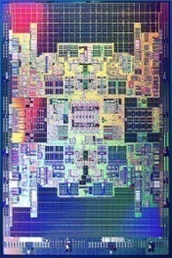
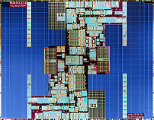
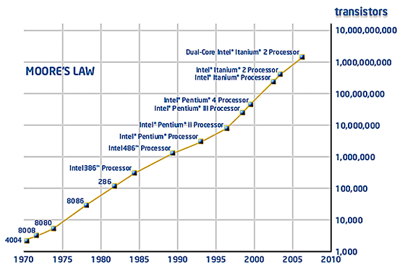
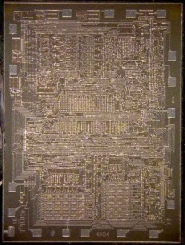

Moore’s Law (Intel’s Roadmap)
90 nm
596 mm²
65 nm
698 mm²
2 billions
Tukwila
1.7 billions
Montecito
3 billions
Nvidia Fermi @40nm
10 μm
13.5mm²
42millions
3.9 billions
Altera Stratix FPGA @28nm
Exponential growth
2,250
Source: Intel Corp.

Slide 11
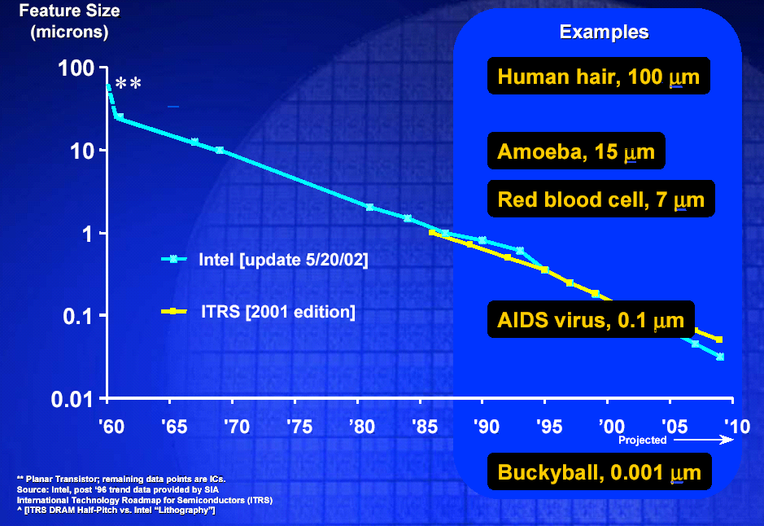
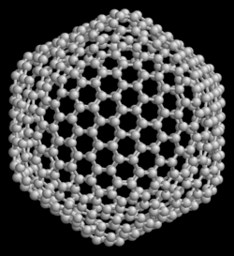
Feature Size
Feature size shrinks by 70% per 18 to 24 months

Slide 12
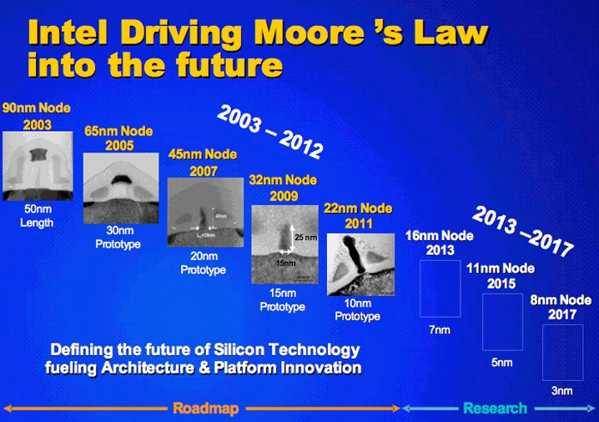
Feature Size (More Recent)

Slide 13
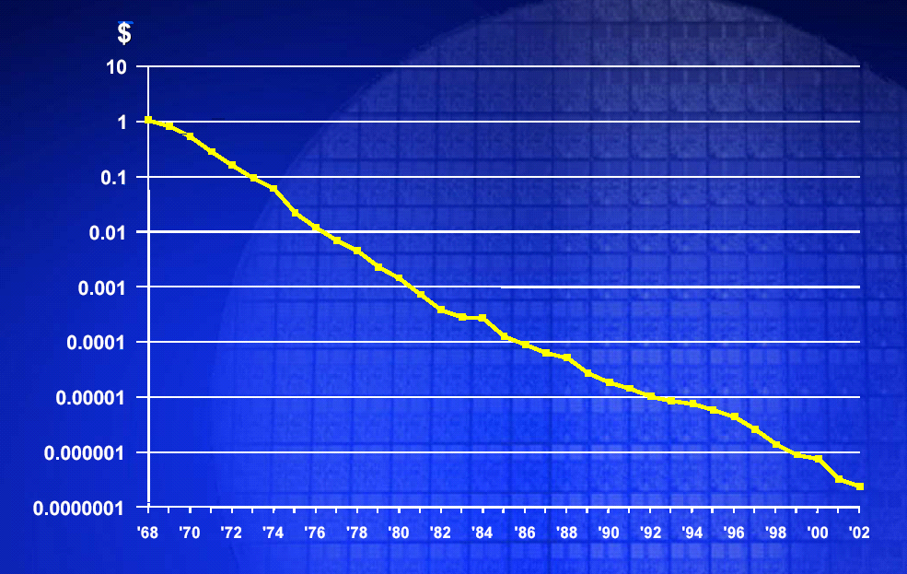
Transistor Cost

Slide 14
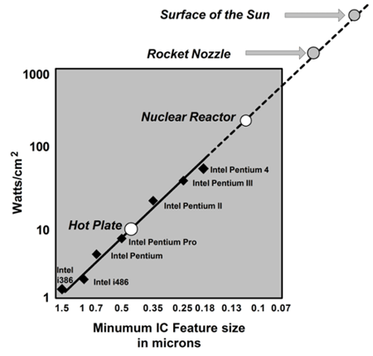

Power Density Trend
Source: Intel Corp.

Slide 15
Outline:
Introduction
Classes of Computers
Defining Computer Architecture
Trends in Technology
Power in Integrated Circuits
Trends in Cost
Dependability
Performance
Quantitative Principles of computer design

Slide 16
Classes of Computers
Desktop/laptops Server Clusters/Warehouse Embedded Personal Mobile device

Slide 17
Classes of Computers
The table below provides the summary of five main stream of computing classes and their characteristics
Feature | Personal Mobile device | Desktop | Server | Clusters/Warehouse | Embedded
Price of system | $100- $1000 | $300 - $2500 | $5000 - $10000000 | $100000 - $200000000 | $10 - $100000
Price of Mp | $10-$100 | $50 - $500 | $200 - $2000 | $50 - $250 | $0.01 - $100
Critical System design issues | Cost, energy, media performance, responsiveness | Price-performance, energy, graphics performance | Throughput, availability, scalability, energy | Price-performance, throughput, energy proportionality | Price, energy, application-specific performance.

Slide 18
Personal Mobile Device (PMD)
These devices include cell phones, tablet computers etc. There are many reasons for these devices to be restricted in use and has following features
Energy efficiency – As batteries are being used.
Less expensive packages – Plastic versus ceramic – Use of fan for cooling and power consumption.
Application is often web-based and media-oriented like google Goggles.
Flash memories are used to restrict the size instead of magnetic disks.
Real-time performance requirement is key factor.
Memory efficiency is another factor. It is required to minimize memory and need to use energy efficiently.
Classes of Computers

Slide 19
Desktop Computing
This includes low-end notebooks to high-end workstations. It is well characterized in terms of applications and benchmarking, through the increasing use of Web-centric, interactive application.
Servers
Servers are used to provide large-scale and reliable file and computing services. The different characteristics for a server are:
Availability is critical.
Scalability – memory, storage and I/O bandwidth.
They are designed for efficient throughput. (The overall performance in terms transactions per minute or web pages served per second is good)
Classes of Computers

Slide 20
Clusters / Warehouse-Scale Computers
Clusters are collections of desktop computers or servers connected by local area networks to act as a single larger computer. Each of the computer has its own OS and they communicate using network protocol.
The largest of the clusters are called warehouse-Scale Computers (WSCs). WSCs are related to servers. The main difference between servers and WSCs is the scalability for a WSC is handled by the local area network connecting the computers and not by integrated computer hardware.
There is a difference between Supercomputers and WSCs. The Supercomputers differ by emphasizing floating-point performance and by running large, communication intensive batch programs that can run for weeks at a time. In contrast
Classes of Computers

Slide 21
WSCs emphasize interactive applications, large-scale storage, dependability and high Internet bandwidth.
Embedded Computers are found in many of the everyday machines. It can be in a Car, motorbike, washing machine, microwaves etc. These computers are limited in hardware and software sophistication.
The characteristic of Embedded computers are-
They are 8-bits, 16-bits or 32 bits microprocessors.
They execute 100 million instruction per second
The cost can be between $5 to $100.
Classes of Computers

Slide 22

Classes of Parallelism and Parallel Architectures
There are two kinds of Parallelism in applications:
Data-Level Parallelism (DLP): It arises because there are many data items that can be operated at the same time.
Task-Level Parallelism (TLP): It arises because of work are created that can operate independently and largely in parallel.
These two types of parallelism can be exploited in four major ways:
Instruction-Level Parallelism
Vector Architectures and Graphic Processor Units (GPUs)
Thread-Level Parallelism
Request -Level Parallelism
Classes of Computers

Slide 23
Michael Flynn [1966] Classification:
Single instruction stream, single data stream (SISD): It is uniprocessor. It is sequential computer but can exploit instruction level parallelism.
Single Instruction Stream, Multiple data Stream (SIMD): -
Single Instruction stream, multiple data streams (SIMD):
Classes of Computers
Interconnection Network
……
……
PE
PE
PE
PE
Control Processor

Slide 24
An SIMD machine executes a single instruction on multiple data values simultaneously using many processors.
Since there is only one instruction, each processor does not have to fetch and decode each instruction. Instead, a single control unit does the fetch and decoding for all processors.
Example: for (i=0; I < 1000; i++)
c[i] = a[i] + b[i]
The add operation can be dispatched to all processors and executed concurrently by them.
This is because various elements of the loop are independent of each other.
c[0] = a[0] + b[0]
c[1] = a[1] + b[1]
Classes of Computers

Slide 25

SIMD relies on the regular structure of computations (such as those in image processing).
It is often necessary to selectively turn off operations on certain data items. For this reason, most SIMD programming paradigms allow for an ``activity mask'', which determines if a processor should participate in a computation or not.
MIMD computers
Computers in which each processing elements is capable of executing a different program independent of each other processing elements are called Multiple Instruction stream, multiple data stream (MIMD).
A simple variant of this model, called single program multiple data mode (SPMD) relies on multiple instances of the same program executing on different data.

Slide 26
MIMD
Simple Diagrammatic Representation (Shared Memory)
The SPMD model has the same expressiveness as the MIMD model since each of the multiple programs can be inserted into one large if-else block with conditions specified by the task identifiers..
M
M
M
M
M
Interconnection Network
PE
PE
PE
PE
PE

Slide 27
Comparison between SIMD, MIMD and SPMD
SIMD computers require less hardware than MIMD computers because they have only one global control unit.
SIMD requires less memory because only one copy of the program needs to be stored. MIMD computers store the program and OS at each processor.
SPMD can be built from inexpensive off-the-self components with relatively little effort in a short amount of time.
SPMD computers require extensive design effort resulting in longer product development times.
Since the underlying serial processors change rapidly, SIMD computers suffer from fast obsolescence. The irregular nature of many applications makes SIMD architectures less suitable. Examples of such platforms include current generation Sun Ultra Servers, SGI Origin Servers, multiprocessor PCs, workstation clusters, and the IBM SP.

Slide 28
If ( B == 0)
C = A;
Else
C = A/B
In the above conditional statement there are two steps-
All processors that have B equal to zero executes the instruction C = A. All other processors are idle.
In the else part of the instruction (C = A/B) is executed by all other processor.
The processor that were active in the first step now becomes idle. This is the drawback of SIMD architecture.
Multiple Instruction streams, Single data Stream (MISD) – No commercial multiprocessor of this type are built.

Slide 29
Outline:
Introduction
Classes of Computers
Defining Computer Architecture
Trends in Technology
Power in Integrated Circuits
Trends in Cost
Dependability
Performance
Quantitative Principles of computer design

Slide 30
Defining Computer Architecture
There are many factors for determining what attributes are important for a new computer. First factor to be considered are:
Maximize performance
Energy efficient
Low Power consumption
Low cost
Easily available
The achieve the above factors there are many aspects that include-
What are the instructions set?
What the functional blocks required?
How to optimize the circuit? (Use integrated circuit design)
For what it is being implemented?
Defining Computer Architecture

Slide 31
The implementation may encompass
Integrated circuit design.
Packaging
Power and cooling process
What knowledge need to be acquired for the above design?
Familiarity of wide range of technologies starting from compilers and operating systems to logic design and packaging. It is not restricted only to instruction set design.
Instruction Set Architecture: The Myopic View of Computer Architecture:
Instruction Set Architecture serves as the boundary between the software and hardware.

Slide 32
1. Classifying Instruction Set Architectures
The Architecture differs based on the internal storage in a processor. The major choices are
Stack
Accumulator or
A set of registers.
The operands are used to access the data for processing. These operands may be named explicitly or implicitly.
Stack Operands: These machines use top of the stack to store the operands. Both the operands are implicit.
Example: ADD
The top of the stack has the second operand and bottom of the stack will have the second operand.

Slide 33
When add is executed, the result will be as follows:
ADD
(FFFE) (FFFC) + (FFFE) Memory content
TOS = TOS + (TOS +1)
(New) (Old)
FULL
FULL
FULL
FULL
FULL
FULL
FULL
TOS
FFFFC
FFFFC
TOS+1
FFFFD
TOS
FFFFD
TOS+2
FFFFE
TOS+1
FFFFE
TOS+3
FFFFF
TOS+2
FFFFF
Before Execution
TOS
After Execution
ALU

Slide 34
Accumulator Computer: In this type of computer, Accumulator is one operand and it is implicit. The other operand may be a register or memory.
TOS
Figure shows Accumulator which is both an implicit input operand and a result destination.
The instructions used to access data from memory is Load and Store.
It is also a single operand instruction. The second operand is always accumulator.
ALU
…

Slide 35
Register Memory Computer Architecture. Here one of the operand is always register. The second operand may be memory.
This is a three operand computer. Where the first and second operand must be a register and the third operand is a memory.
To access data from memory Load and Store instructions are used.
Example Load R1, A
Load R2, C
The operations are performed using 3 operands. ADD R3, R1, B
ALU
…

Slide 36
Register – Register Architecture: This is like the stack architecture, in which all arithmetic operations can be performed using registers only. The transfer to the register is possible using Load and Store instructions.
This is also three operand instruction.
Load R1, A
Store R2, C
ADD R1, R2, R3
ALU

Slide 37
Example: Evaluation the expression (A*B)-(B*C)- (A*D)
Stack Computer:
LOAD A
LOAD B
MUL
LOAD B
LOAD C
MUL
LOAD A
LOAD D
MUL
SUB
SUB
Here the hardware must evaluate the expression on only one order, since operands are hidden on the stack and it may have to load an operand multiple times.
The number of instruction also increases. (Code density is large).
Parallelism cannot be achieved. The number of access increases.

Slide 38
Registers can be used to hold variables. The advantages are –
The memory traffic reduces.
The execution of the program will be fast (Speed up)
The size of the program reduces (Code density improves)
Increasing the number of registers improves the performance. There are two version of increasing the number of registers.
Dedicating registers to special uses – This reduces the number of general purpose registers. If the number of truly general –purpose registers is too small, it would be a disadvantage of dedicating variables to registers. Compilers will reserve all the uncommitted registers for use in expression evaluation.

Slide 39
2. Memory Addressing:
All the instruction are byte addressed and provide access for bytes (8 bits), half words (16 bits), and words (32 bits). Most of the computers also provide access for double words (64 bits).
There are two different conventions for ordering the bytes within a larger object.
Little Endian
Big Endian
Example: Consider a number 0x01234567 to be represented in little Endian and big Endian
Little Endian
Big Endian
7 | 6 | 5 | 4 | 3 | 2 | 1 | 0
0 | 1 | 2 | 3 | 4 | 5 | 6 | 7
67 | 45 | 23 | 01
01 | 23 | 45 | 67

Slide 40
Alignment of data:
It is necessary for the data to be aligned. An access to an object of size s bytes at byte address A is aligned if A mod s=0. Misalignment of data causes hardware complications. This will result in multiple access of data from memory.
Width
Byte
Half Word Half word
Word
Word
Double word
0 | 1 | 2 | 3 | 4 | 5 | 6 | 7
Aligned | Aligned | Aligned | Aligned | Aligned | Aligned | Aligned | Aligned
Aligned |  | Aligned |  | Aligned |  | Aligned
 | Misaligned |  | Misaligned |  | Misaligned
Aligned |  |  |  | Alligned
 | Misaligned |  |  |  | Misaligned
 |  | Misaligned

Slide 41
3.Addressing Modes: Addressing modes specify constants and registers in addition to the process of addressing locations in memory. When a memory location is used, the actual memory address specified by the addressing mode is called the effective address.
Register Add R4, R3
Immediate Add R2, #2000
Displacement ADD R3, 100(R1)
Register indirect Add R4, (R1)
Indexed Add R3, (R1+R2)
Direct or Absolute Add R1, (100)
Memory indirect Add R1, @(R3)
Auto increment Add R1, (R3)+
Auto decrement Add R1, -(R3)
Scaled Add R1, 100(R3)(R1)

Slide 42
4. Types and sizes of operands
Operands are provided along with the operation codes in an instruction. There are instructions with zero operand to three operands. There may be more number of operands depending on special type of computers.
Usually the type of an operand—integer, single-precision floating point, character, and so on—effectively gives its size. Character (8 bits), half word (16 bits), word (32 bits), single-precision floating point (also 1 word), and double-precision floating point (2 words). Integers are almost universally represented as two’s complement binary numbers. Characters are usually in ASCII, but the 16-bit Unicode (used in Java) is used internationalization of computers.

Slide 43
For business applications, some architectures support a decimal format called packed decimal or binary-coded decimal—4 bits:
0000 – 0, 0001 – 1, 0010 – 2 … 1001 – 9
2 decimal digits are packed into each byte.
Example
32 – 0011 0010
87 – 1000 0111
Numeric character strings are sometimes called unpacked decimal.
Example 1872 is represented as
Byte representation: 01 08 07 02 Four location
Binary representation:00000001 00001000 00000111 00000010

Slide 44
Operations in the Instruction Set:
Operator type Examples
Arithmetic and logical | Integer arithmetic and logical operations: add, subtract, and, or, multiply, divide
Data transfer | Loads-stores (move instructions on addressing)
Control | Branch, jump, procedure call and return, traps
System | Operating system call, virtual memory management instructions
Floating point | Floating-point operations: add, multiply, divide, compare
Decimal | Decimal add, decimal multiply, decimal-to-character conversions
String | String move, string compare, string search
Graphics | Pixel and vertex operations, compression/ decompression operations

Slide 45
6. Instructions for Control Flow
We can distinguish four different types of control flow change:
■ Conditional branches
■ Jumps
■ Procedure calls
■ Procedure returns
Control flow instructions are best when they are PC-relative. It means that the branch takes up by adding the constant provided as an operand to the contents of the PC.
PC-relative branches or jumps are advantageous because the target is often near the current instruction, and specifying the position relative to the current PC requires fewer bits. Using
PC-relative addressing also permits the code to run independently of where it is loaded. This property, called position independence

Slide 46
To implement returns and indirect jumps when the target is not known at compile time, a method other than PC-relative addressing is required. It means dynamically address need to be specified.
Dynamic address may be as simple as naming a register that contains the target address; alternatively, the jump may permit any addressing mode to be used to supply the target address.
These register indirect jumps are also useful for four other important features:
■ Case or switch statements
■ Virtual functions or methods in object-oriented languages like C++ or Java

Slide 47
■ High-order functions or function pointers in languages like C or C++
■ Dynamically shared libraries
In all four cases the target address is not known at compile time, and hence is usually loaded from memory into a register before the register indirect jump.
Conditional Branch Options
Since most changes in control flow are branches, deciding how to specify the branch condition is important. The three primary techniques used and their advantages and disadvantages are:

Slide 48
Name | condition | Advantages | Disadvantages
Condition code (CC) | Tests special bits set by ALU operations, possibly under program control. | Sometimes condition is set for free. | Condition is extra state. It may be true or false resulting multiple operations.
Condition register | Tests arbitrary register with the result of a comparison. | Simple. | Uses up a register.
Compare and branch | Compare is part of the branch. Often compare is limited to subset. | One instruction rather than two for a branch. | May be too much work per instruction for pipelined execution.
Procedure Invocation Options
Procedure calls and returns include control transfer and possibly some state saving; at a minimum the return address must be saved

Slide 49
somewhere, sometimes in a special link register or just a GPR. Some older architectures provide a mechanism to save many registers, while newer architectures require the compiler to
generate stores and loads for each register saved and restored.
7. Encoding an Instruction Set
When encoding the instructions, the number of registers and the number of addressing modes both have a significant impact on the size of instructions, as the register field and addressing mode field may appear many times in a single instruction.
Most instructions many more bits are consumed in encoding
addressing modes and register fields than in specifying the opcode. The architect must balance several competing forces when encoding the instruction set:

Slide 50
1. The desire to have as many registers and addressing modes as possible.
2. The impact of the size of the register and addressing mode fields on the average instruction size and hence on the average program size.
3. A desire to have instructions encoded into lengths that will be easy to handle in a pipelined implementation. Many desktop and server architects have chosen to use a fixed-length instruction to gain implementation benefits while sacrificing average code size.

Slide 51
Outline:
Introduction
Classes of Computers
Defining Computer Architecture
Trends in Technology
Power in Integrated Circuits
Trends in Cost
Dependability
Performance
Quantitative Principles of computer design

Slide 52
There are Five implementation technologies, which change at a dramatic pace that are critical to modern implementations:
Integrated circuit logic technology: Transistor density increases by about 35% per year, quadrupling over four years. The growth rate in transistor count on a chip of about 40% to 55% per year, or doubling every 18 to 24 months. This trend is popularly known as Moore’s law.
Semiconductor DRAM: Capacity per DRAM chip has increased by about 25% to 40% per year recently, doubling roughly every two to three years.
Semiconductor Flash (electrically erasable programmable read-only memory) Capacity per Flash chip has increased by about 50% to 60% per year recently, doubling roughly every two years.

Slide 53
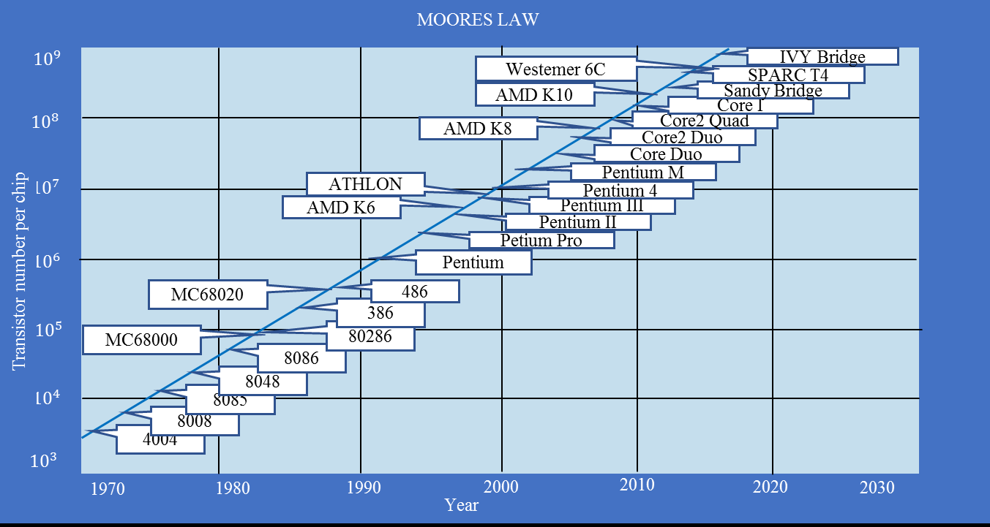

Slide 54
Magnetic disk technology: Density has increased about 40% per year, or doubled every three years. Disks are 15 to 25 times cheaper per bit than Flash. Given the slowed growth rate of DRAM, disks are now 300 to 500 times cheaper per bit than DRAM.
Network technology—Network performance depends both on the performance of switches and on the performance of the transmission system.
Performance Trends: Bandwidth over Latency:
Bandwidth or Throughput is the total amount of work done in a given time, such as megabytes per second for a disk transfer

Slide 55
Latency or Response time is the time between the start and the completion of an event, such as milliseconds for a disk access.

Slide 56
Outline:
Introduction
Classes of Computers
Defining Computer Architecture
Trends in Technology
Power in Integrated Circuits
Trends in Cost
Dependability
Performance
Quantitative Principles of computer design

Slide 57
Trends in Power and Energy in Integrated Circuits
Power is the biggest challenge facing the computer designer for nearly every class of computer.
Power must be brought in and distributed around the chip, and modern microprocessors use hundreds of pins and multiple interconnect layers just for power and ground.
Power is dissipated as heat and must be removed.
Power and Energy: A Systems Perspective
How should a system architect or a user think about performance, power, and energy? There are three primary concerns.

Slide 58
what is the maximum power a processor ever requires?
Based on this input, system designer need to provide correct SMPS (Switch Mode Power Supply). if a processor attempts to draw more power than a power supply system can provide (by drawing more current than the system can supply), the result is typically a voltage drop, which can cause the device to malfunction.
2. What is the sustained power consumption? This metric is widely called the thermal design power (TDP), since it determines the cooling requirement.
TDP is neither peak power, which is often 1.5 times higher, nor is it the actual average power that will be consumed during a given computation, which is likely to be lower still.

Slide 59
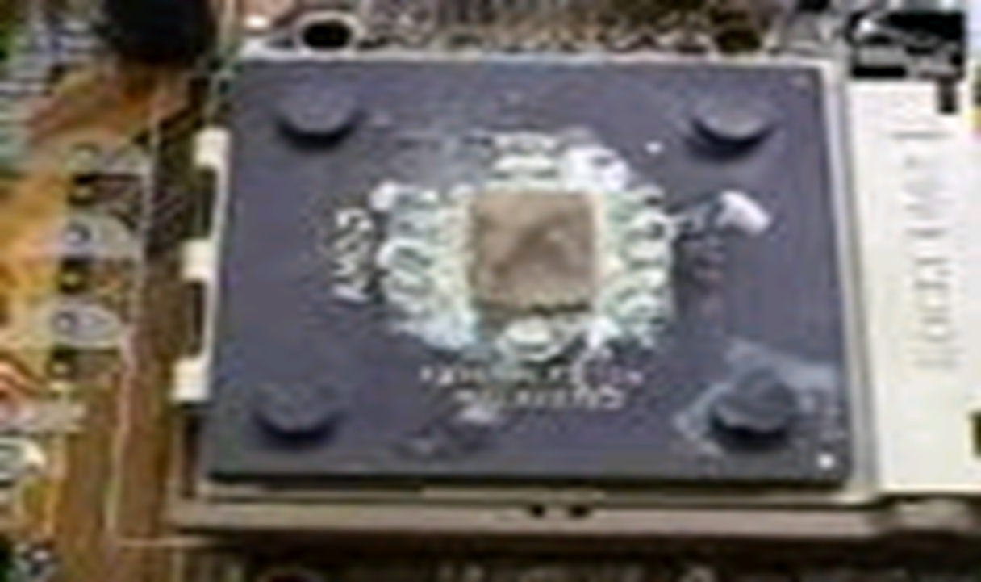
A system is required for cooling to match or exceed TDP. Failure to provide adequate cooling will allow the junction temperature in the processor to exceed its maximum value, resulting in device failure and possibly permanent damage.

Slide 60
3. Energy and energy efficiency is the next factor.
Power is energy per unit time: 1 watt = 1 joule per second.
Which metric is the right one for comparing processors: energy or power? In general, energy is always a better metric because it is tied to a specific task and the time required for that task. In particular, the energy to execute a workload is equal to the average power times the execution time for the
workload.
Compare processor A having 20% higher average power consumption over a processor B. A executes a task only 70% of the time needed by B. Which processor is better?
A energy consumption will be 1.2 × 0.7 = 0.84. Hence Processor A is better.

Slide 61
Energy and Power within a Microprocessor
Dynamic energy required per transistor is proportional to the product of the capacitive load driven by the transistor and the square of the voltage:
Energy_{dynamic} ∝ Capacitive load × Voltage²
This equation is the energy of pulse of the logic transition of 0→1→0 or 1→0→1.
The energy of a single transition (0→1 or 1→0) is then:
Energy_{dynamic} ∝ (½)Capacitive load × Voltage²
The power required per transistor is just the product of the energy of a transition multiplied by the frequency of transitions:
Power_{dynamic} ∝ (½) × Capacitive load x Voltage² × Frequency
switched
For a fixed task, slowing clock rate reduces power, but not energy.

Slide 62
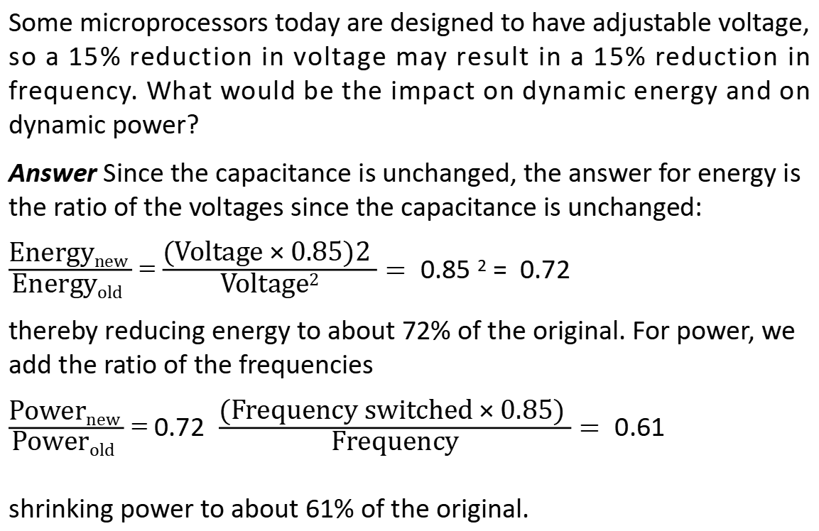
Some microprocessors today are designed to have adjustable voltage, so a 15% reduction in voltage may result in a 15% reduction in frequency. What would be the impact on dynamic energy and on dynamic power?
Answer Since the capacitance is unchanged, the answer for energy is the ratio of the voltages since the capacitance is unchanged:
$\frac{\text{Energy}\text{new} }{\text{Energy}\text{old} }$ = $\frac{\text{(}\text{Voltage}\text{ × }\text{0}\text{.}\text{85}\text{)}\text{2} }{\text{Voltage}\text{2}}=$0.85 ² = 0.72
thereby reducing energy to about 72% of the original. For power, we add the ratio of the frequencies
$\frac{\text{Power}\text{new} }{\text{Powe}\text{r}\text{old} }$ = 0.72 $\frac{\text{(}\text{Frequency} \text{switched}\text{ × }\text{0}\text{.}\text{85}\text{) }}{\text{Fr}\text{e}\text{quency}}=$0.61
shrinking power to about 61% of the original.

Slide 63
The first microprocessors consumed less than a watt and the first 32-bit microprocessors (like the Intel 80386) used about 2 watts, while a 3.3 GHz Intel Core i7 consumes 130 watts.

Slide 64
Using transistors the major constraint is power. Which causes heat due frequency. Distributing the power, removing the heat, and preventing hot spots have become a challenges.
Microprocessors offer many techniques to improve energy efficiency despite flat clock rates and constant supply voltages they are –
Do nothing well: To turn off the clock of inactive modules to save energy and dynamic power. For example, if no floating-point instructions are executing, the clock of the floating-point unit is disabled. If some cores are idle, their clocks are stopped.
Dynamic Voltage-Frequency Scaling (DVFS): There are periods of low activity while using a system, where there is no need to operate at the highest clock frequency and voltages. Modern microprocessors typically offer a few clock frequencies and voltages in which to operate that use lower power and energy.

Slide 65
3. Design for typical case. Given that systems are often idle, memory and storage offer low power modes to save energy. For example, DRAMs have a series of increasingly lower power modes to extend battery life in PMDs and laptops, and there have been proposals for disks that have a mode that spins at lower rates when idle to save power. Alas, you cannot access DRAMs or disks in these modes, so you must return to fully active mode to read or write, no matter how low the access rate.
Systems are designed relying on on-chip temperature sensors to detect when activity should be reduced automatically
to avoid overheating.
4. Overclocking: Intel started offering Turbo mode in 2008, where the chip decides that it is safe to run at a higher clock rate for a short time possibly on just a few cores until temperature starts to rise. For example, the 3.3 GHz Core i7 can run in short bursts for 3.6 GHz. Indeed, the highest-performing microprocessors each year since 2008

Slide 66
Static power is power consumed while there is no circuit activity. Static power is becoming an important issue because
leakage current flows even when a transistor is off.
Power_{static} ∝ Current_{static} × Voltage
That is, static power is proportional to number of devices.
Thus, increasing the number of transistors increases power even if they are idle, and leakage current increases in processors with smaller transistor sizes.
Leakage can be as high as 50% for such chips, in part because of the large Static RAM caches that need power to maintain the storage values.

Slide 67
Because the processor is just a portion of the whole energy cost of a system, it can make sense to use a faster, less energy-efficient processor to allow the rest of the system to go into a sleep mode. This strategy is known as race-to-halt.

Slide 68
Outline:
Introduction
Classes of Computers
Defining Computer Architecture
Trends in Technology
Power in Integrated Circuits
Trends in Cost
Dependability
Performance
Quantitative Principles of computer design

Slide 69
The cost of a manufactured computer component decreases over time.
Whether it is a chip, a board, or a system, designs that have twice the yield will have half the cost.
Volume is a second key factor in determining cost. Increasing volumes affect cost in several ways.
They decrease the time needed to get down the learning curve, which is partly proportional to the number of systems (or chips) manufactured.
volume decreases cost, since it increases purchasing and manufacturing efficiency. As a rule of thumb, some designers have estimated that cost decreases about 10% for each doubling of volume.
Competition decreases the gap between cost and selling price, but it also decreases cost.

Slide 70
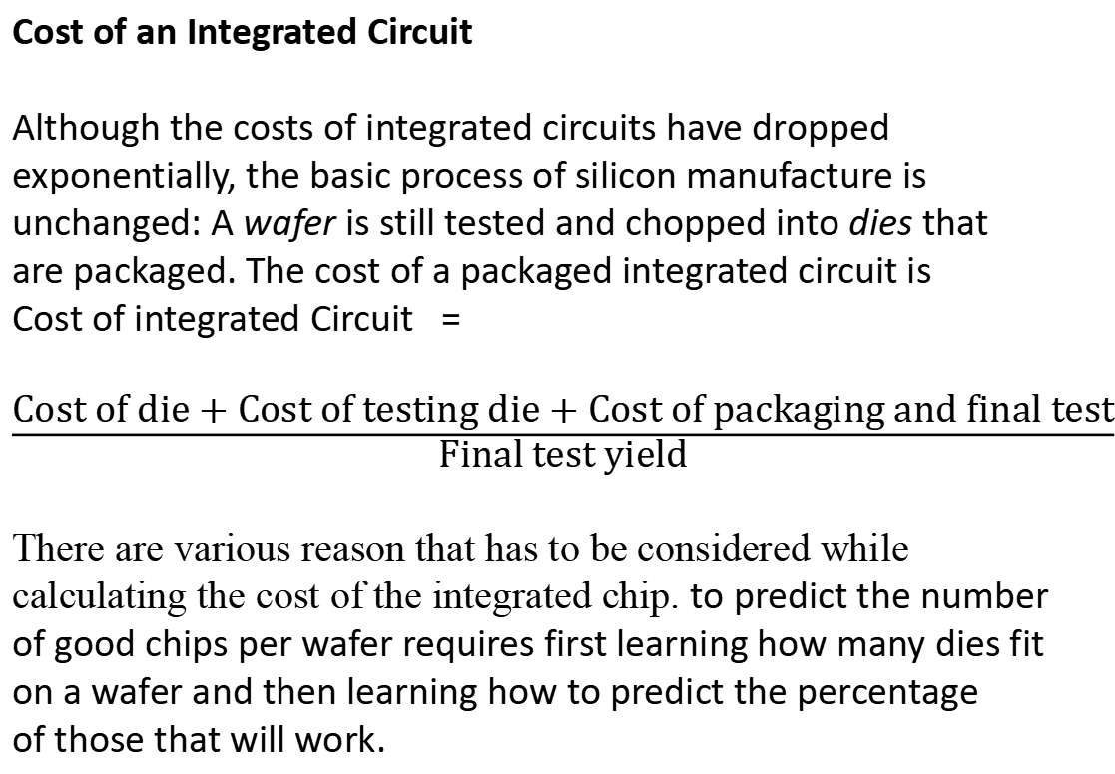
Cost of an Integrated Circuit
Although the costs of integrated circuits have dropped exponentially, the basic process of silicon manufacture is unchanged: A wafer is still tested and chopped into dies that are packaged. The cost of a packaged integrated circuit is
Cost of integrated Circuit =
$\frac{\text{Cost} \text{of} \text{die}\text{ + }\text{Cost} \text{of} \text{testing} \text{die}\text{ + }\text{Cost} \text{of} \text{packaging} \text{and} \text{final} \text{test}}{\text{Final} \text{test} \text{yield}}$
There are various reason that has to be considered while calculating the cost of the integrated chip. to predict the number of good chips per wafer requires first learning how many dies fit on a wafer and then learning how to predict the percentage
of those that will work.

Slide 71
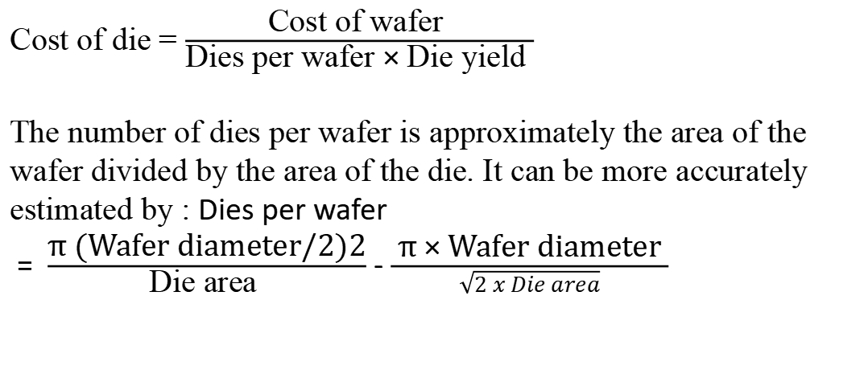
Cost of die = $\frac{\text{Cost} \text{of} \text{wafer} }{\text{Dies} \text{per} \text{wafer}\text{ × }\text{Die} \text{yield} }$
The number of dies per wafer is approximately the area of the wafer divided by the area of the die. It can be more accurately estimated by : Dies per wafer
= $\frac{\text{π}\text{ (}\text{Wafer} \text{diameter}\text{/}\text{2}\text{)}\text{2}}{\text{Die} \text{area} }$ - $\frac{ \text{π}\text{ × }\text{Wafer} \text{diameter} }{\sqrt{2 x Die area}}$

Slide 72
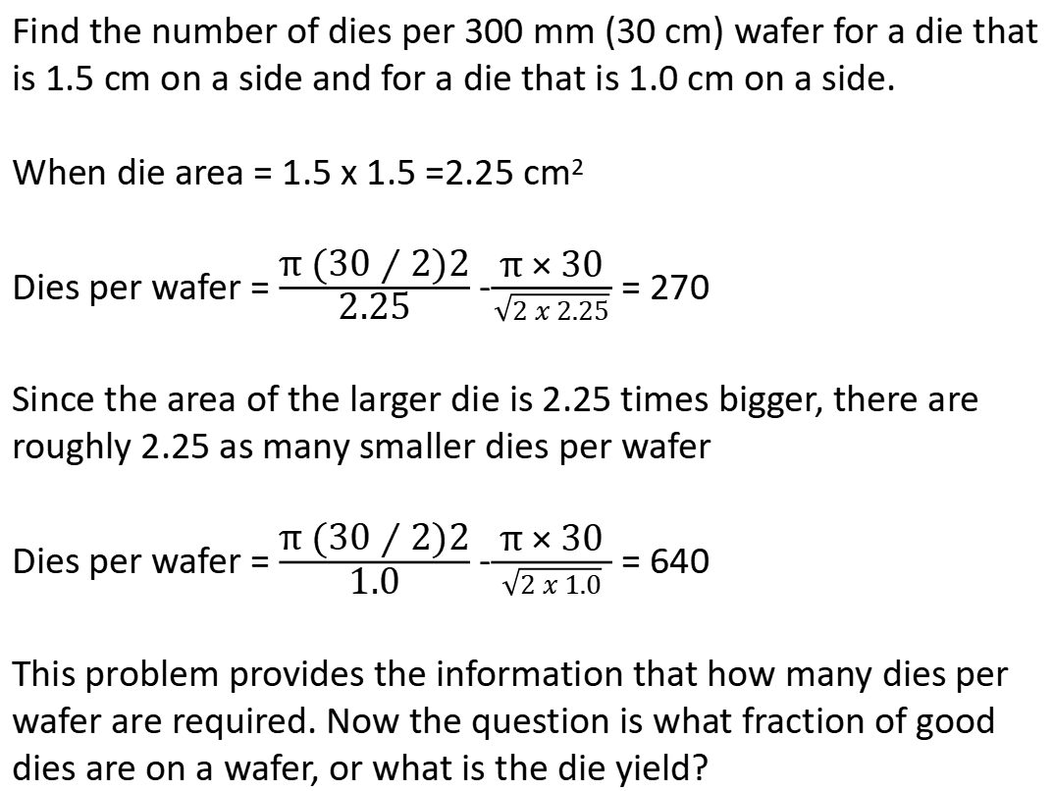
Find the number of dies per 300 mm (30 cm) wafer for a die that is 1.5 cm on a side and for a die that is 1.0 cm on a side.
When die area = 1.5 x 1.5 =2.25 cm²
Dies per wafer = $\frac{\text{π}\text{ (}\text{30}\text{ ⁄ }\text{2}\text{)}\text{2}}{\text{2}\text{.}\text{25}}$ -$\frac{ \text{π}\text{ × }\text{30} }{\sqrt{2 x 2.25}}$ = 270
Since the area of the larger die is 2.25 times bigger, there are roughly 2.25 as many smaller dies per wafer
Dies per wafer = $\frac{\text{π}\text{ (}\text{30}\text{ ⁄ }\text{2}\text{)}\text{2}}{\text{1}\text{.}\text{0}}$ -$\frac{ \text{π}\text{ × }\text{30} }{\sqrt{2 x 1.0}}$ = 640
This problem provides the information that how many dies per wafer are required. Now the question is what fraction of good dies are on a wafer, or what is the die yield?

Slide 73
Die yield = Wafer yield 1 ⁄ (1 + Defects per unit area × Die area)^{N}
N is a parameter called the process-complexity factor, a measure of manufacturing difficulty. N ranged from 11.5 to 15.5.
Problem:
Find the die yield for dies that are 1.5 cm on a side and 1.0 cm on a side, assuming a defect density of 0.031 per cm² and N is 13.5.
Answer The total die areas are 2.25 cm² and 1.00 cm². For the larger die, the yield is
Die yield = 1 ⁄ (1 + 0.031 × 2.25)^{13.5} = 0.40
For the smaller die, the yield is
Die yield = 1 ⁄ (1 + 0.031 × 1.00)^{13.5} = 0.66
That is, less than half of all the large dies are good but two-thirds of the small dies are good.

Slide 74
Good dies per wafer = dies per wafer x die yield
2.25 cm² dies from the 300mm wafer = 270 x 0.4 = 108
1.0 cm2 dies from the 300 mm wafer = 640 x 0.66 = 422
To increase the yield, designers include redundancy. The cost of a 200mm (12 inches) diameter wafer cost between $5000 and $6000 in 2010.
Assuming the processed wafer cost = $ 5500
The cost of 1.00 cm² die would be around $13.
The cost for 2.25cm² die would be around $51

Slide 75
What are the factors a designer must remember while calculating the cost of the chip?
The manufacturing process dictates the wafer cost, wafer yield, and defects per unit area.
So the sole control of the designer is die area. In practice, because the number of defects per unit area is small, the number of good dies per wafer, and hence the cost per die, grows roughly as the square of the die area.
The computer designer affects die size, and hence cost, both by what functions are included on or excluded from the die and by the number of I/O pins.

Slide 76
The cost is divided into two parts:
Variable costs of producing a functional die which is appropriate for high-volume integrated circuits.
Fixed costs that can significantly affect the cost of an integrated circuit for low volumes (less than 1 million parts), namely, the cost of a mask set.
Cost versus Price
The margin between the cost to manufacture a product and the price the product sells for has been shrinking. This margin pay for the company’s research and development, marketing, sales manufacturing equipment maintenance, building rental, cost of financing, pretax profits, and taxes.
Most companies spend only 4% (in the commodity PC business) to 12% (in the High-end server business) of their income on R&D, which includes all engineering.

Slide 77
Outline:
Introduction
Classes of Computers
Defining Computer Architecture
Trends in Technology
Power in Integrated Circuits
Trends in Cost
Dependability
Performance
Quantitative Principles of computer design

Slide 78
Dependability: A common meaning of dependability is:
capable of being depended on; worthy of trust; reliable: a dependable employee.
Service level agreements (SLAs)- to guarantee that their networking or power service would be dependable. For example, they would pay the customer a penalty if they did not meet an agreement more than some hours per month. Thus, an SLA could be used to decide whether the system was up or down.
Systems alternate between two states of service with respect to an SLA:
1. Service accomplishment, where the service is delivered as specified
2. Service interruption, where the delivered service is different from the SLA

Slide 79
Transitions between these two states are caused by failures (from state 1 to state 2) or restorations (2 to 1).
Module reliability is a measure of the continuous service accomplishment (or, equivalently, of the time to failure) from a reference initial instant.
Hence, the mean time to failure (MTTF) is a reliability measure. The reciprocal of MTTF is a rate of failures, generally reported as failures per billion hours of operation, or FIT (for failures in time).
Thus, an MTTF of 1,000,000 hours equals 10⁹/10⁶ or 1000 FIT. Service interruption is measured as mean time to repair (MTTR). Mean time between failures (MTBF) is simply the sum of
MTTF + MTTR.

Slide 80
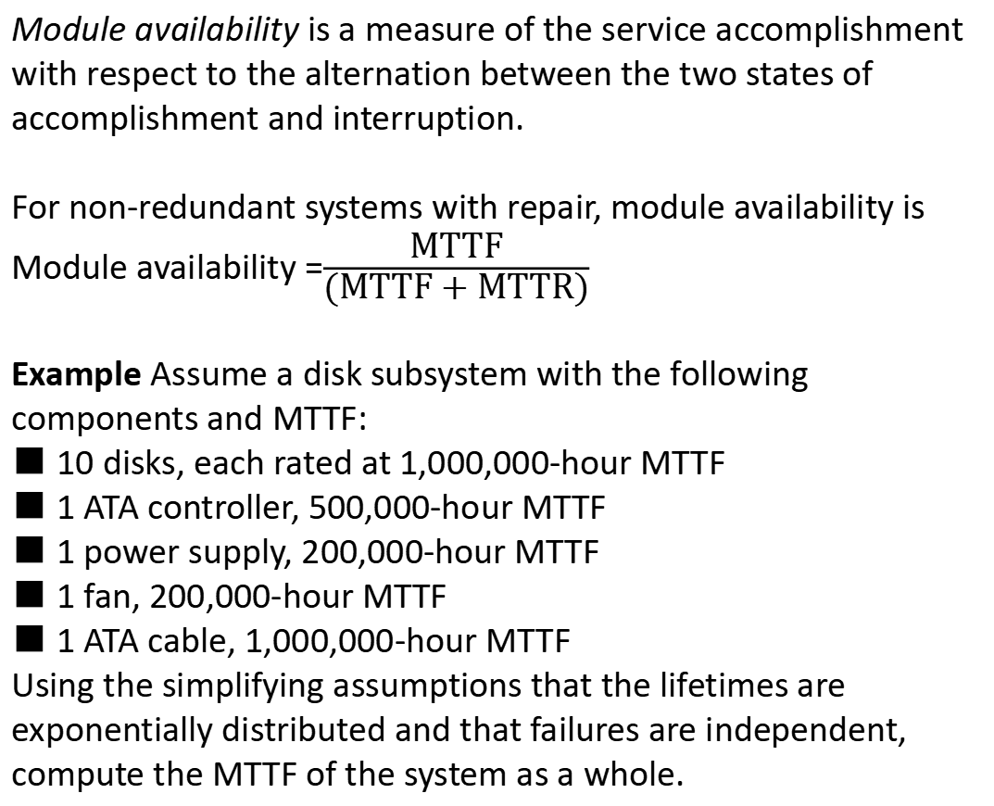
Module availability is a measure of the service accomplishment with respect to the alternation between the two states of accomplishment and interruption.
For non-redundant systems with repair, module availability is
Module availability =$\frac{\text{MTTF}}{\text{(}\text{MTTF}\text{ + }\text{MTTR}\text{)}}$
Example Assume a disk subsystem with the following components and MTTF:
■ 10 disks, each rated at 1,000,000-hour MTTF
■ 1 ATA controller, 500,000-hour MTTF
■ 1 power supply, 200,000-hour MTTF
■ 1 fan, 200,000-hour MTTF
■ 1 ATA cable, 1,000,000-hour MTTF
Using the simplifying assumptions that the lifetimes are exponentially distributed and that failures are independent, compute the MTTF of the system as a whole.

Slide 81
The sum of the failure rates is
Failure rate _{System}= 10* (1/1000000) + (1/500000) + (1/200000) + (1 / 200,000) + (1/1,000,000) =
(23000/1000000000) hours
Or 23000 FIT.
MTTF _{System} = (1/Failure rate _{system}) = (23000/ 1000000000) = 43500 hrs or just under 5 years.
Example: Disk subsystems often have redundant power supplies to improve dependability. Using the components and MTTFs from above, calculate the reliability of redundant power supplies. Assume one power supply is sufficient to run the disk subsystem and that we are adding one redundant power supply.

Slide 82
Assume that the lifetimes of the components are exponentially distributed and that there is no dependency between the component failures.
MTTF for redundant power supplies is the mean time until one power supply fails divided by the chance that the other will fail before the first one is replaced.
If the chance of a second disk failure before repair is small, then the MTTF of the pair is large.
Since there are two power supplies and independent failures, the mean time until one disk fails is MTTF_{power supply}/2. A good approximation of the probability of a second failure is MTTR over the mean time until the other power supply fails.

Slide 83

Hence, a reasonable approximation for a redundant pair of power supplies is
MTTF _{power supply pair} = $\frac{MTTFpower supply /2}{\frac{MTTRpower supply}{MTTFpower supply}}$ = $\frac{MTTF2power supply}{\text{2} \text{x} \text{MTTR}power supply}$
Assume it takes on average 24 hours for a human operator to notice that a power supply has failed and replace it, the reliability of the fault tolerant pair of power supplies is
MTTF _{power supply pair} = $\frac{MTTF2power supply}{\text{2} \text{x} \text{MTTR}power supply}$ = $\frac{2000002}{\text{2} \text{x} \text{24}}$ = 830000000
This means that making a pair of power supply results in about 4150 times more reliable than a single power supply.

Slide 84
Outline:
Introduction
Classes of Computers
Defining Computer Architecture
Trends in Technology
Power in Integrated Circuits
Trends in Cost
Dependability
Performance
Quantitative Principles of computer design

Slide 85
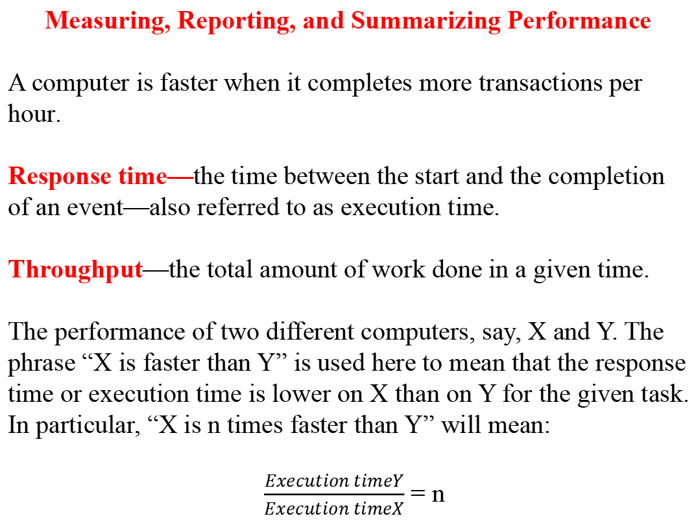
Measuring, Reporting, and Summarizing Performance
A computer is faster when it completes more transactions per hour.
Response time—the time between the start and the completion of an event—also referred to as execution time.
Throughput—the total amount of work done in a given time.
The performance of two different computers, say, X and Y. The phrase “X is faster than Y” is used here to mean that the response time or execution time is lower on X than on Y for the given task. In particular, “X is n times faster than Y” will mean:
$\frac{Execution timeY}{Execution timeX}$ = n

Slide 86
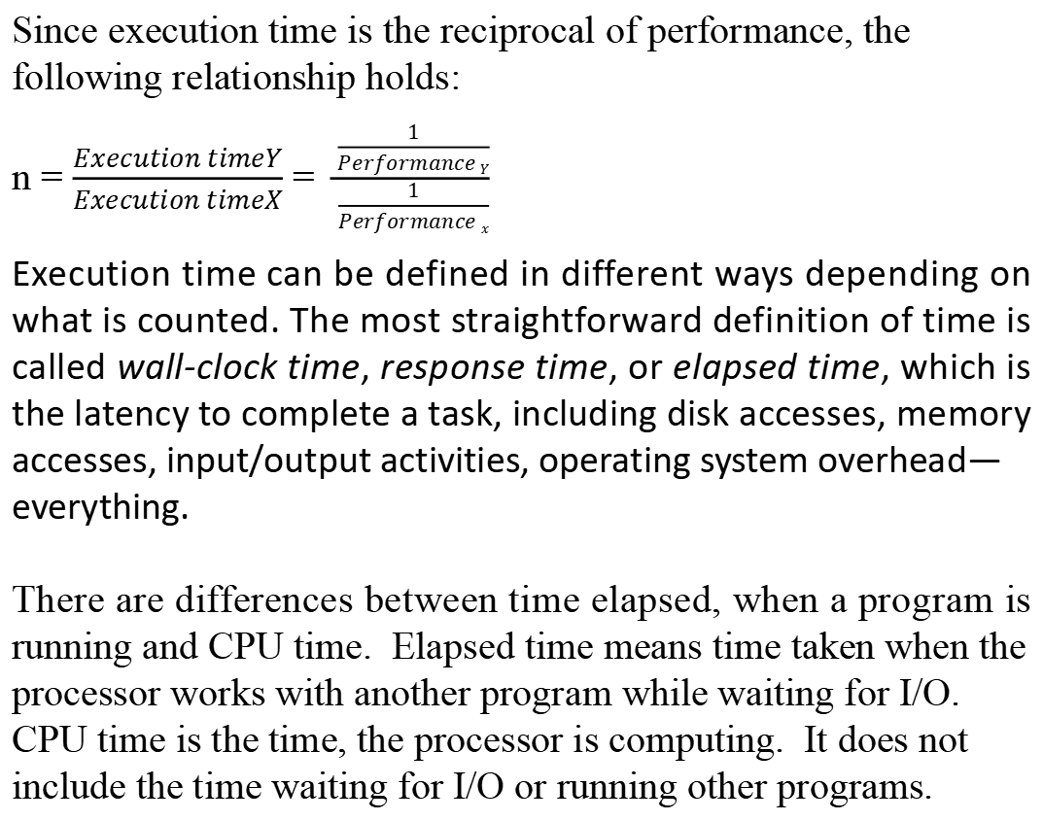
Since execution time is the reciprocal of performance, the following relationship holds:
n = $\frac{Execution timeY}{Execution timeX}$ = $\frac{\frac{1}{Performance Y}}{\frac{1}{Performance x}}$
Execution time can be defined in different ways depending on what is counted. The most straightforward definition of time is called wall-clock time, response time, or elapsed time, which is the latency to complete a task, including disk accesses, memory accesses, input/output activities, operating system overhead—
everything.
There are differences between time elapsed, when a program is running and CPU time. Elapsed time means time taken when the processor works with another program while waiting for I/O.
CPU time is the time, the processor is computing. It does not include the time waiting for I/O or running other programs.

Slide 87
Benchmarks
The best choice of benchmarks is to measure performance in real applications.
The benchmark programs must be of greater than or equal to running application programs. If it is not used the performance will be bad. Examples include:
■ Kernels, which are small, key pieces of real applications
■ Toy programs, which are 100-line programs from beginning programming assignments, such as quicksort
■ Synthetic benchmarks, which are fake programs invented to try to match the profile and behavior of real applications, such as Dhrystone.

Slide 88
All three are discredited because the compiler writer and architect conspire to make the computer appear faster on these stand-in programs than on real applications.
One way to improve the performance of a benchmark has been with bench mark specific flags; these flags often caused transformations that would be illegal on many programs or would slow down performance on others.
To restrict this process and increase the significance of the results, benchmark developers often require the vendor to use one compiler and one set of flags for all the programs in
the same language (C++ or C). In addition to the question of compiler flags, another question is whether source code modifications are allowed.
There are three different approaches to addressing this question:

Slide 89
No source code modifications are allowed.
2. Source code modifications are allowed but are essentially impossible. For example, database benchmarks rely on standard database programs that are tens of millions of lines of code. The database companies are highly unlikely to make changes to enhance the performance for one particular computer.
3. Source modifications are allowed, as long as the modified version produces the same output.
A popular measure of performance of processors is with a variety of applications. These collections of benchmark applications are called benchmark suites.
The goal of a benchmark suite is that it will characterize the relative performance of two computers, particularly for programs not in the suite that customers are likely to run.

Slide 90
One of the most successful attempts to create standardized benchmark application suites has been the SPEC (Standard Performance Evaluation Corporation) used for workstations.
All the SPEC benchmark suites and their reported results are found at www.spec.org.
Desktop Benchmarks
Desktop benchmarks are divided into two broad classes: processor-intensive benchmarks and
graphics-intensive benchmarks
SPEC benchmarks are real programs modified to be portable and to minimize the effect of I/O on performance. The integer benchmarks vary from part of a C compiler to a chess program to a quantum computer simulation.

Slide 91
The floating point benchmarks include structured grid codes for finite element modelling, particle method codes for molecular dynamics, and sparse linear algebra codes for fluid dynamics.
Server Benchmarks:
Most server applications and benchmarks have significant
I/O activity arising from either disk or network traffic, including benchmarks for file server systems, for Web servers, and for database and transaction processing systems.
SPEC offers both a file server benchmark (SPECSFS) and a
Web server benchmark (SPECWeb). SPECSFS is a benchmark for measuring NFS (Network File System) performance using a script of file server requests; it tests the performance of the I/O system (both disk and network I/O) as well as the processor.

Slide 92
Transaction-processing (TP) benchmarks measure the ability of a system to handle transactions that consist of database accesses and updates. Example: Airline reservation systems and bank ATM systems.

Slide 93
Outline:
Introduction
Classes of Computers
Defining Computer Architecture
Trends in Technology
Power in Integrated Circuits
Trends in Cost
Dependability
Performance
Quantitative Principles of computer design

Slide 94
Take Advantage of Parallelism
Taking advantage of parallelism is one of the most important methods for improving performance. They are at three levels.
The use of parallelism at the system level
To improve the throughput performance on a typical server benchmark, multiple processors and multiple disks can be used. The workload of handling requests can then be spread among the processors and disks, resulting in improved throughput.
Being able to expand memory and the number of processors
and disks is called scalability, and it is a valuable asset for servers.
Spreading of data across many disks for parallel reads and writes enables data-level parallelism.

Slide 95
2. At the level of an individual processor, taking advantage of parallelism among instructions is critical to achieving high performance. One of the simplest ways to do this is through pipelining. Pipelining is the best-known example of instruction-level parallelism.
3. Parallelism can also be exploited at the level of detailed digital design. For example, set-associative caches use multiple banks of memory that are typically searched in parallel to find a desired item.
Use carry-look-ahead, which uses parallelism to speed the process of computing sums from linear to logarithmic in the number of bits per operand. These are more examples of data-level parallelism.

Slide 96
Principle of Locality
Programs tend to reuse data and instructions they have used recently. This program property is the principle of locality.
A widely held rule of thumb is that a program spends 90% of its execution time in only 10% of the code. An implication of locality is that we can predict with reasonable accuracy what instructions and data a program will use in the near future based on its accesses in the recent past. The principle of locality also applies to data accesses, though not as strongly as to code accesses.
There are two types of Principal of Locality.
Temporal locality states that recently accessed items are likely to be accessed in the near future.
Spatial locality says that items whose addresses are near one another tend to be referenced close together in time.

Slide 97
Focus on the Common Case
Focusing on the common case works for power as well as for resource allocation and performance. The instruction fetch and decode unit of a processor may be used much more frequently than a multiplier, It requires optimization first. It works on dependability as well.
Concentrating on frequent used units may result in improving making these units faster. A fundamental law called Amdahl’s law can be used to quantify this principle.
Amdahl’s Law:
Amdahl’s law states that the performance improvement to be gained from using some faster mode of execution is limited by the fraction of the time the faster mode can be used.

Slide 98
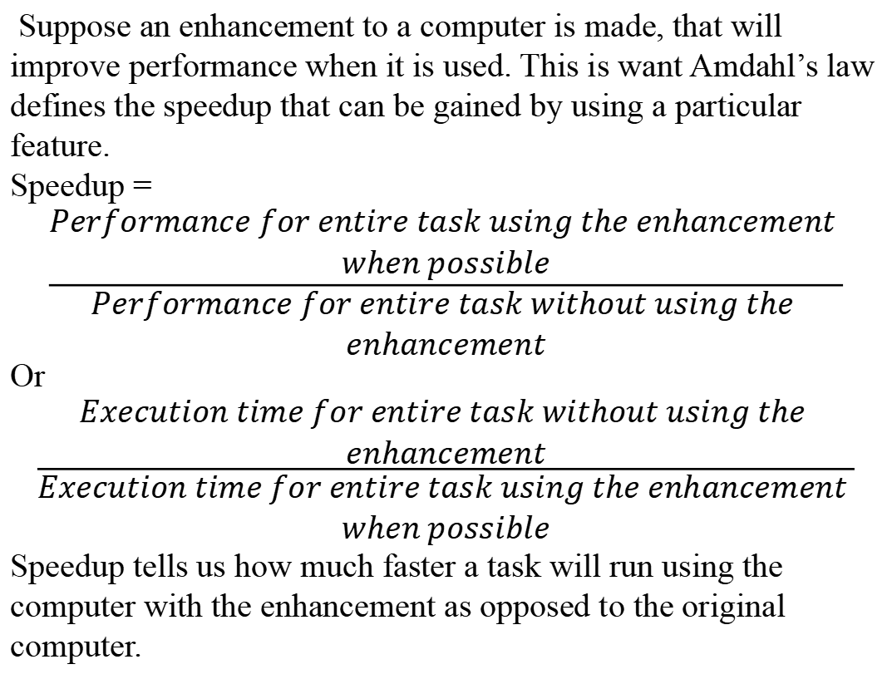
Suppose an enhancement to a computer is made, that will improve performance when it is used. This is want Amdahl’s law defines the speedup that can be gained by using a particular feature.
Speedup =
$$\frac{\begin{aligned}Performance for entire task using the enhancement \\ when possible\end{aligned}}{\begin{aligned}Performance for entire task without using the \\ enhancement\end{aligned}}$$
Or
$$\frac{\begin{aligned}Execution time for entire task without using the \\ enhancement\end{aligned}}{\begin{aligned}Execution time for entire task using the enhancement \\ when possible\end{aligned}}$$
Speedup tells us how much faster a task will run using the computer with the enhancement as opposed to the original computer.

Slide 99
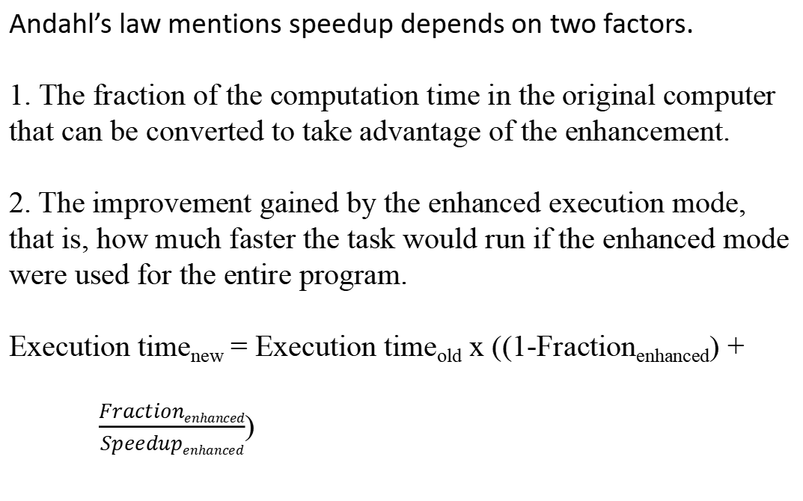
Andahl’s law mentions speedup depends on two factors.
1. The fraction of the computation time in the original computer that can be converted to take advantage of the enhancement.
2. The improvement gained by the enhanced execution mode, that is, how much faster the task would run if the enhanced mode were used for the entire program.
Execution time_{new} = Execution time_{old} x ((1-Fraction_{enhanced}) +
$\frac{Fractionenhanced}{Speedupenhanced}$)

Slide 100
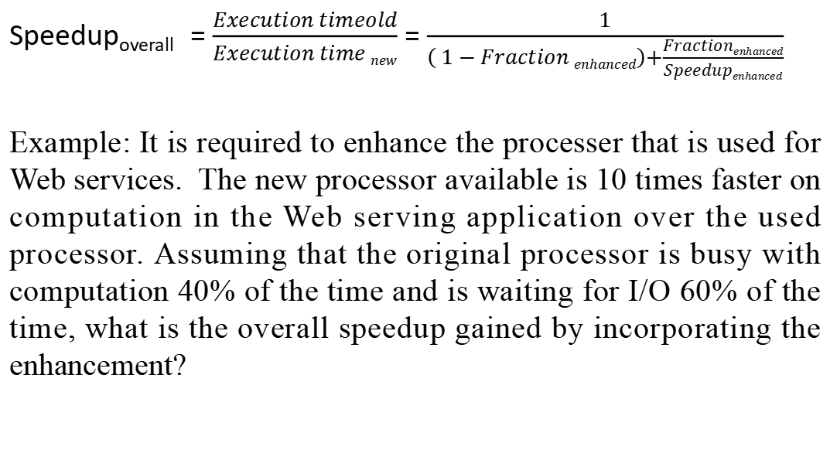
Speedup_{overall} = $\frac{Execution timeold}{Execution time new}$ = $\frac{1}{\left( 1 − Fraction enhanced\right)+\frac{Fractionenhanced}{Speedupenhanced}}$
Example: It is required to enhance the processer that is used for Web services. The new processor available is 10 times faster on computation in the Web serving application over the used processor. Assuming that the original processor is busy with computation 40% of the time and is waiting for I/O 60% of the time, what is the overall speedup gained by incorporating the enhancement?

Slide 101
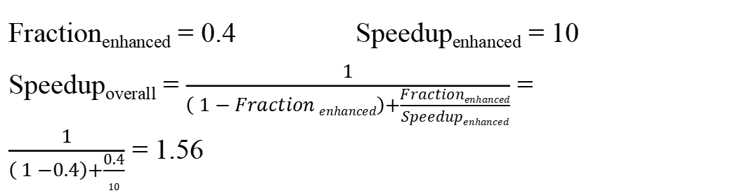
Fraction_{enhanced} = 0.4 Speedup_{enhanced} = 10
Speedup_{overall} = $\frac{1}{\left( 1 − Fraction enhanced\right)+\frac{Fractionenhanced}{Speedupenhanced}}$ =
$\frac{1}{\left( 1 −0.4\right)+\frac{0.4}{10}}$ = 1.56

Slide 102
Amdahl’s law expresses the law of diminishing returns: The incremental improvement in speedup gained by an improvement of just a portion of the computation diminishes as improvements are added.
Amdahl’s law is that if an enhancement is only usable for a fraction of a task then we can’t speed up the task by more than the reciprocal of 1 minus that fraction.
Example:
A common transformation required in graphics processors is square root. Implementations of floating-point (FP) square root vary significantly in performance, especially among processors designed for graphics. Suppose FP square root (FPSQR) is responsible for 20% of the execution time of a critical graphics benchmark. One proposal is to enhance the FPSQR hardware and speed up this operation by a factor of 10. The other alternative is

Slide 103
just to try to make all FP instructions in the graphics processor run faster by a factor of 1.6; FP instructions are responsible for half of the execution time for the application. The design team believes that they can make all FP instructions run 1.6 times faster with the same effort as required for the fast square root. Compare these two design alternatives.

Slide 104
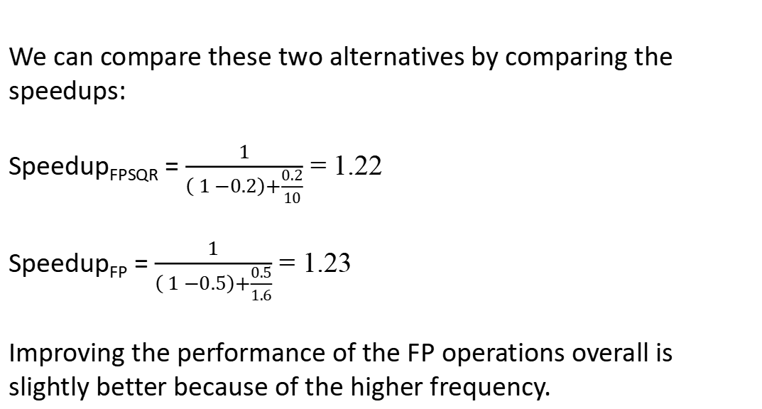
We can compare these two alternatives by comparing the speedups:
Speedup_{FPSQR} = $\frac{1}{\left( 1 −0.2\right)+\frac{0.2}{10}}$ = 1.22
Speedup_{FP} = $\frac{1}{\left( 1 −0.5\right)+\frac{0.5}{1.6}}$ = 1.23
Improving the performance of the FP operations overall is slightly better because of the higher frequency.

Slide 105
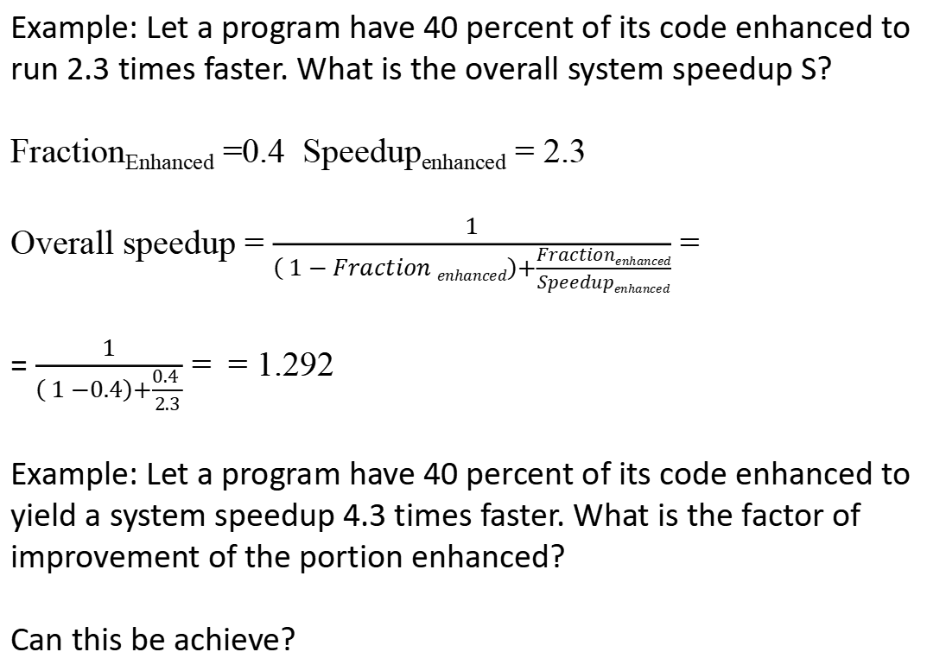
Example: Let a program have 40 percent of its code enhanced to run 2.3 times faster. What is the overall system speedup S?
Fraction_{Enhanced} =0.4 Speedup_{enhanced} = 2.3
Overall speedup = $\frac{1}{\left( 1 − Fraction enhanced\right)+\frac{Fractionenhanced}{Speedupenhanced}}$ =
= $\frac{1}{\left( 1 −0.4\right)+\frac{0.4 }{2.3}}$ = = 1.292
Example: Let a program have 40 percent of its code enhanced to yield a system speedup 4.3 times faster. What is the factor of improvement of the portion enhanced?
Can this be achieve?

Slide 106
In other words, let us determine if by enhancing 40% of the system code, it is possible to make the system to go 4.3 time faster?
Let Speedup be denoted by “S”, fraction enhanced be denoted by “f_{E}”, and factor of improvement be denoted by “f_{I}”. Then we can write the above equation as
S = ( (1 –f_{E}) + (f_{E}/ f_{I}) )-1.
Step1: Assume the limit, where f_{l} = infinity, so
S = ( (1 –f_{E}) + (f_{E}/ f_{I}) )⁻¹.
S = 1/ (1 –f_{E})
Step 2: Plug in values & solve S = ( (1 –0.4) )⁻¹= 1 / 0.6 = 1.67
Step 3: So S = 1.67 is the maximum possible speedup, and we cannot achieve S = 4.3 !!

Slide 107
Amdahl’s Law for Multiple Tasks
Average execution rate
(performance)
Fraction of results
generated at this rate
Note: Not “fraction
of time spent working
at this rate”

Slide 108
Example
30% of results are generated at the rate of 1 MFLOPS,
20% at 10 MFLOPS,
50% at 100 MFLOPS.
What is the average performance in MFLOPS?
What is the bottleneck?
Bottleneck: the rate that consumes most of the time

Slide 109
Another Example
Which change is more effective on a certain machine: speeding up 10-fold
the floating point square root operation only, which takes up 20% of
execution time, or speeding up 2-fold all floating point operations, which
take up 50% of total execution time?
(Assume that the cost of accomplishing either change is the same, and the
two changes are mutually exclusive.)
F_{sqrt} = fraction of FP sqrt results
R_{sqrt} = rate of producing FP sqrt results
F_{non-sqrt} = fraction of non-sqrt results
R_{non-sqrt} = rate of producing non-sqrt results
F_{fp} = fraction of FP results
R_{fp} = rate of producing FP results
F_{non-fp} = fraction of non-FP results
R_{non-fp} = rate of producing non-FP results
R_{before} = average rate of producing results before enhancement
R_{after} = average rate of producing results after enhancement
Notes:
Note that there are three categories of operations here: floating point square root operations, other floating point operations, and non-FP operations. When we change one of these categories, we group the other two categories as the “other case”.

Slide 110
Solution using Amdahl’s Law
Improve FP sqrt only
Improving all FP operations
is more effective
Improve all FP ops

Slide 111
Implications of Amdahl’s Law
Improvements provided by a feature limited by how often feature is used
As stated, Amdahl’s Law is valid only if the system always works with exactly one of the rates
Overlap between CPU and I/O operations? Amdahl’s Law as given here is not applicable
Bottleneck is the most promising target for improvements
“Make the common case fast”
Infrequent events, even if they consume a lot of time, will make little difference to performance
Typical use: Change only one parameter of system, and compute effect of this change
The same program, with the same input data, should run on the machine in both cases

Slide 112
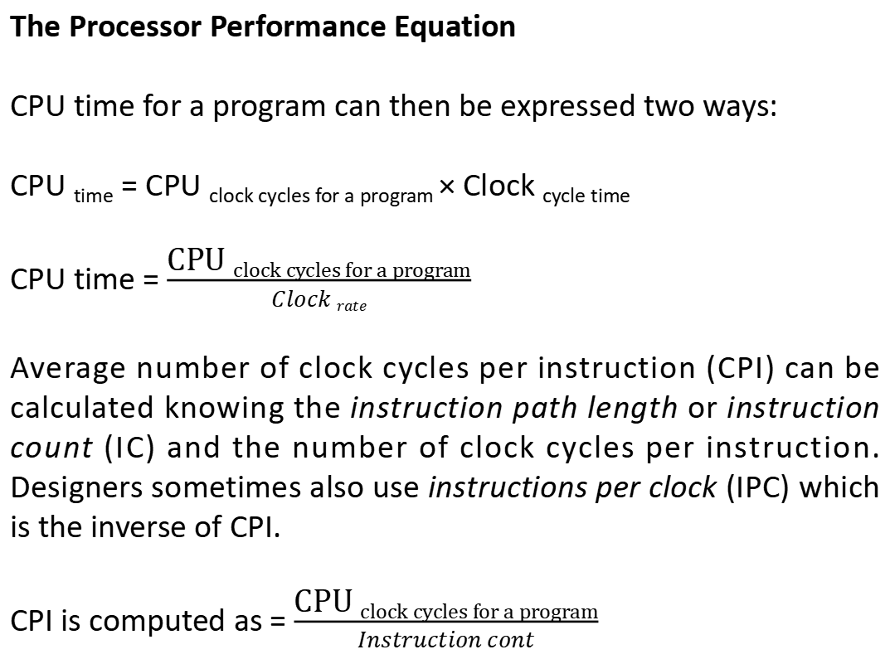
The Processor Performance Equation
CPU time for a program can then be expressed two ways:
CPU _{time} = CPU _{clock cycles for a program} × Clock _{cycle time}
CPU time = $\frac{\text{CPU} \text{clock} \text{cycles} \text{for} \text{a} \text{program}}{Clock rate}$
Average number of clock cycles per instruction (CPI) can be calculated knowing the instruction path length or instruction count (IC) and the number of clock cycles per instruction. Designers sometimes also use instructions per clock (IPC) which is the inverse of CPI.
CPI is computed as = $\frac{\text{CPU} \text{clock} \text{cycles} \text{for} \text{a} \text{program}}{Instruction cont}$

Slide 113
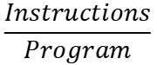
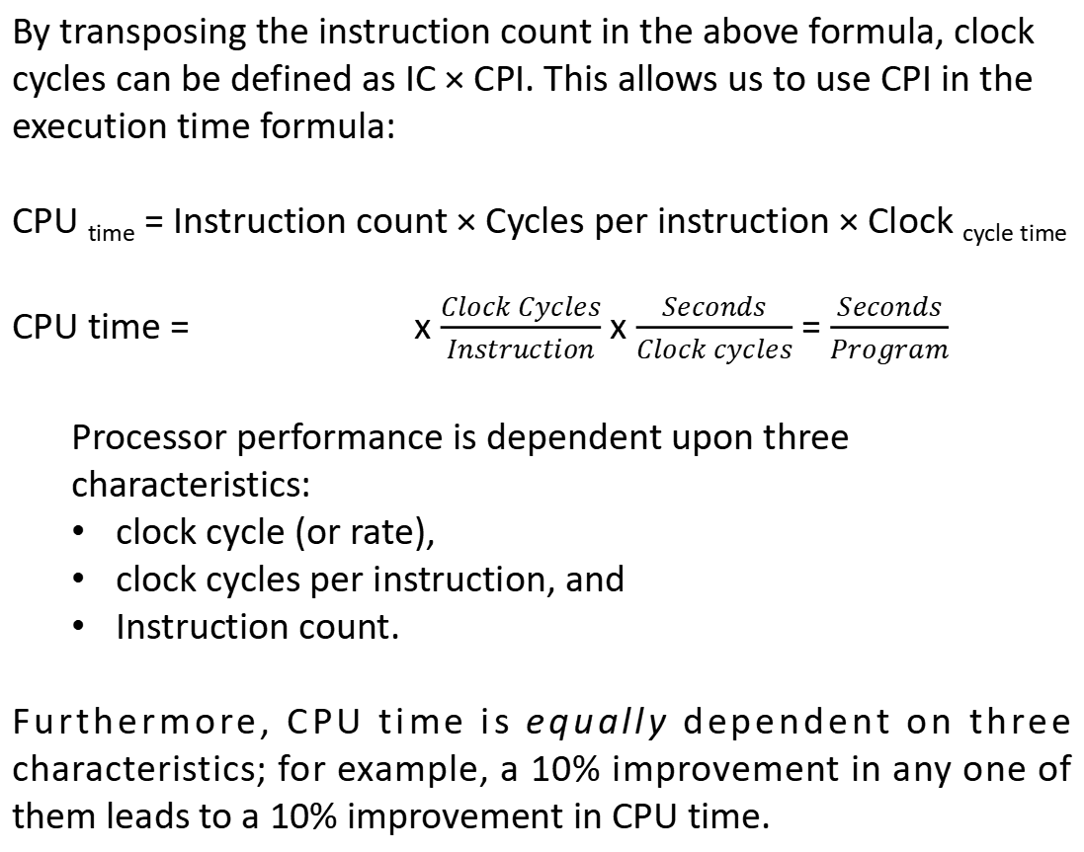
By transposing the instruction count in the above formula, clock cycles can be defined as IC × CPI. This allows us to use CPI in the execution time formula:
CPU _{time} = Instruction count × Cycles per instruction × Clock _{cycle time}
CPU time = x $\frac{Clock Cycles}{Instruction}$ x $\frac{Seconds}{Clock cycles}$ = $\frac{Seconds}{Program}$
Processor performance is dependent upon three characteristics:
clock cycle (or rate),
clock cycles per instruction, and
Instruction count.
Furthermore, CPU time is equally dependent on three characteristics; for example, a 10% improvement in any one of them leads to a 10% improvement in CPU time.
$$\frac{Instructions}{Program}$$

Slide 114
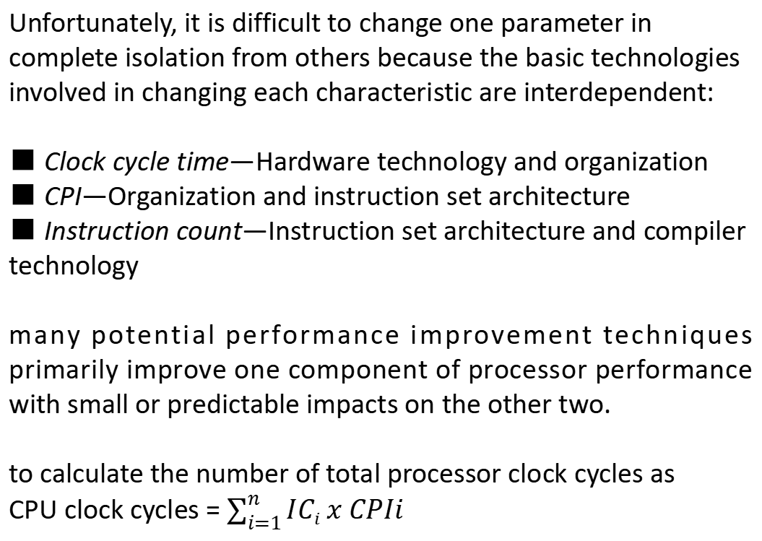
Unfortunately, it is difficult to change one parameter in complete isolation from others because the basic technologies involved in changing each characteristic are interdependent:
■ Clock cycle time—Hardware technology and organization
■ CPI—Organization and instruction set architecture
■ Instruction count—Instruction set architecture and compiler technology
many potential performance improvement techniques primarily improve one component of processor performance with small or predictable impacts on the other two.
to calculate the number of total processor clock cycles as
CPU clock cycles = $\sum_{i=1}^{n}{ICi x CPIi}$

Slide 115
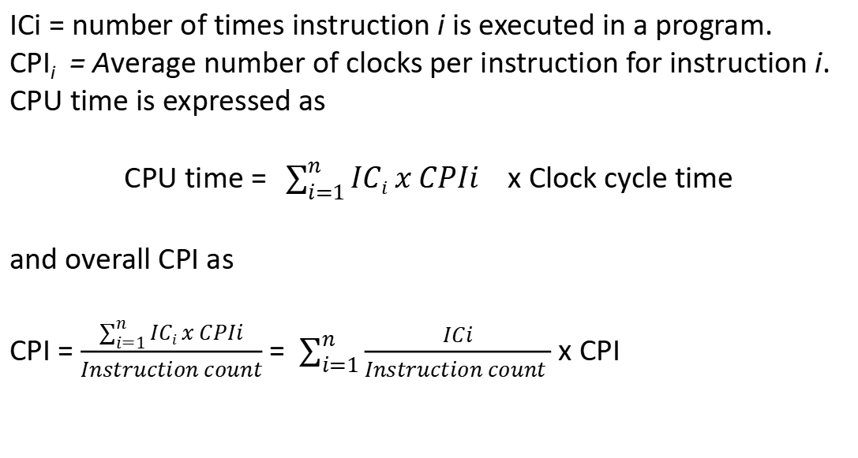
ICi = number of times instruction i is executed in a program.
CPI_{i} = Average number of clocks per instruction for instruction i.
CPU time is expressed as
CPU time = $\sum_{i=1}^{n}{ICi x CPIi}$ x Clock cycle time
and overall CPI as
CPI = $\frac{\sum_{i=1}^{n}{ICi x CPIi}}{Instruction count}$ = $\sum_{i=1}^{n}{\frac{ICi}{Instruction count }}$ x CPI

Slide 116
Processor Performance Eqn
How can we improve performance?

Slide 117
Example 1
A LOAD/STORE machine has the characteristics shown below. We also
observe that 25% of the ALU operations directly use a loaded value that is
not used again. Thus we hope to improve things by adding new ALU
instructions that have one source operand in memory. The CPI of the new
instructions is 2. The only unpleasant consequence of this change is that
the CPI of branch instructions will increase from 2 to 3. Overall, will CPU
performance increase?

Slide 118
Example 1 (Solution)
Before change
After change
Since CPU time increases, change will not improve performance.

Slide 119
Example 2
A load-store machine has the characteristics shown below. An optimizing
compiler for the machine discards 50% of the ALU operations, although it
cannot reduce loads, stores, or branches. Assuming a 500 MHz (2 ns)
clock, what is the MIPS rating for optimized code versus unoptimized code?
Does the ranking of MIPS agree with the ranking of execution time?

Slide 120
Example 2 (Solution)
Without optimization
With optimization
Performance increases,
but MIPS decreases!

Slide 121
Performance of (Blocking) Caches
no cache misses!
with cache misses!
IC – instruction count

Slide 122
Example
Assume we have a machine where the CPI is 2.0 when all
memory accesses hit in the cache. The only data accesses
are loads and stores, and these total 40% of the instructions.
If the miss penalty is 25 clock cycles and the miss rate is 2%,
how much faster would the machine be if all memory
accesses were cache hits?
Why?

Slide 123
Is there a difference between Supercomputers and Warehouse-Scale Computers?
There is a difference between Supercomputers and WSCs. The Supercomputers differ by emphasizing floating-point performance and by running large, communication intensive batch programs that can run for weeks at a time. In contrast WSCs emphasize interactive applications, large-scale storage, dependability and high Internet bandwidth.

